Slide 1
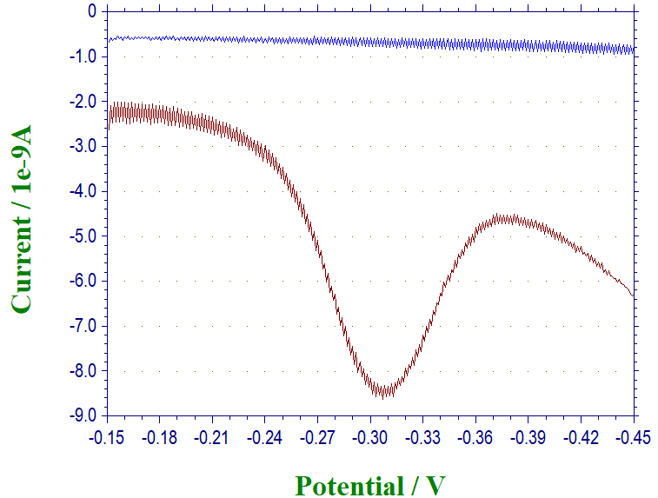
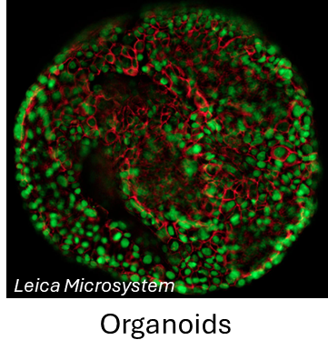
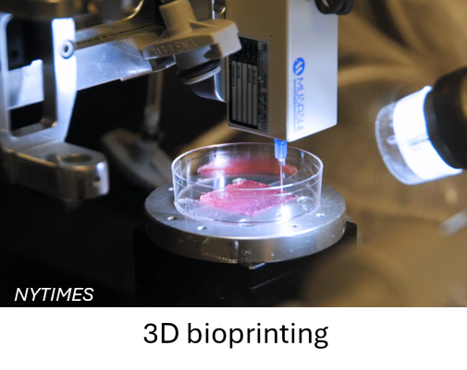
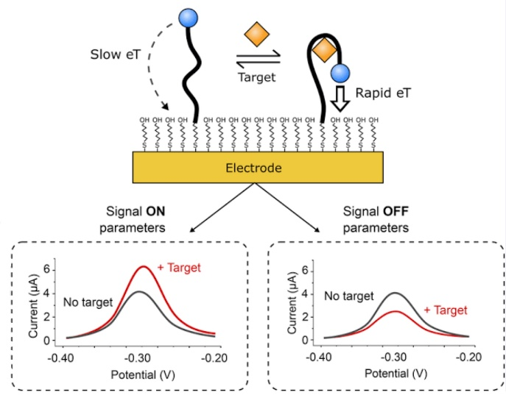

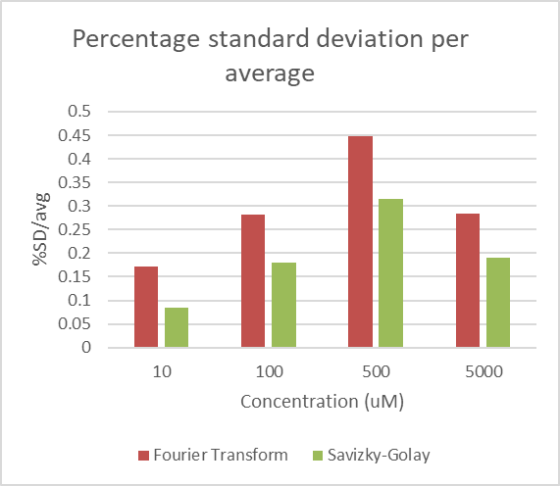


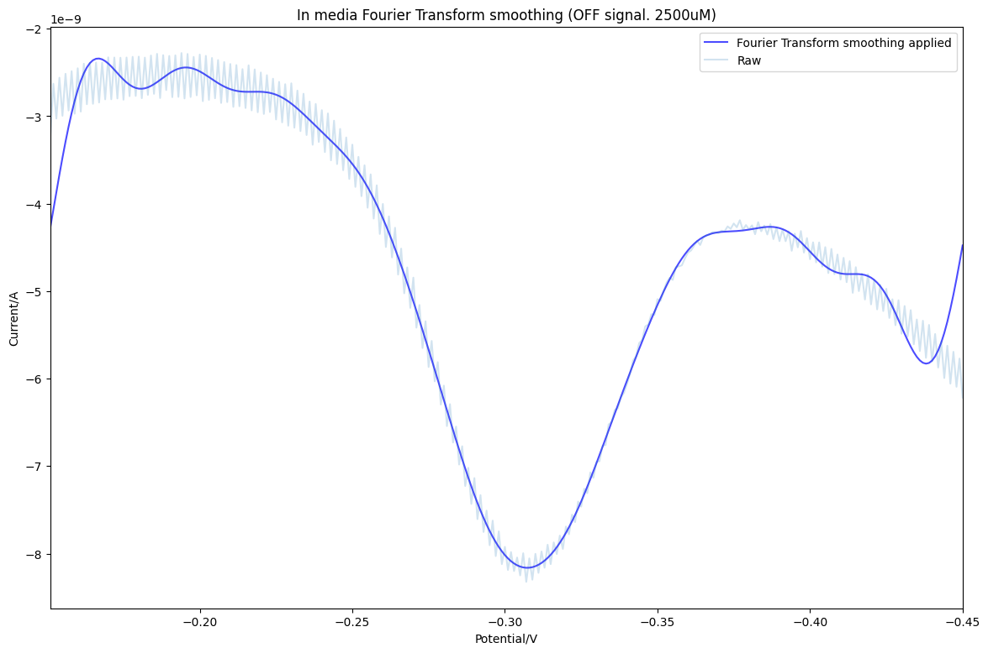
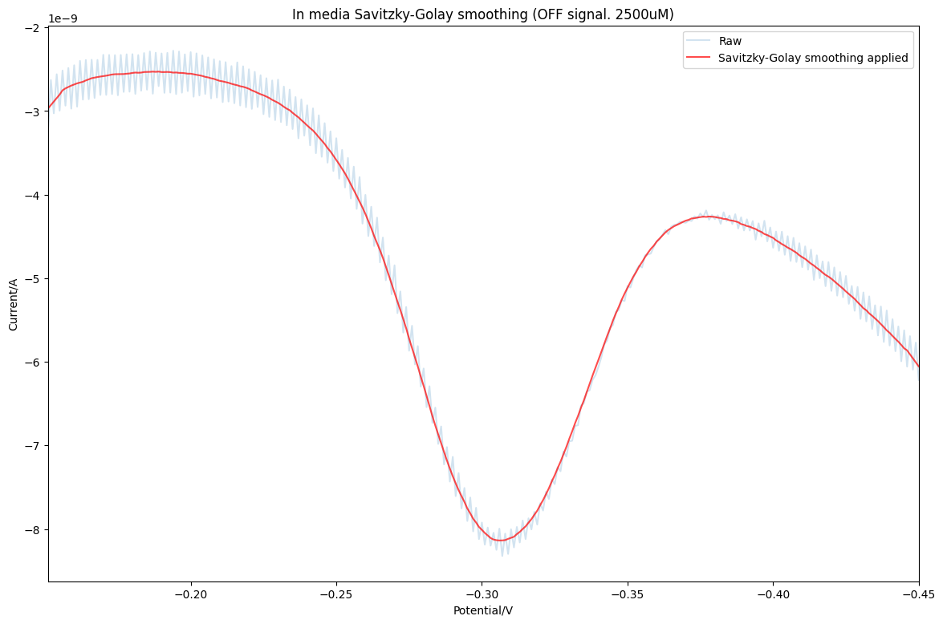



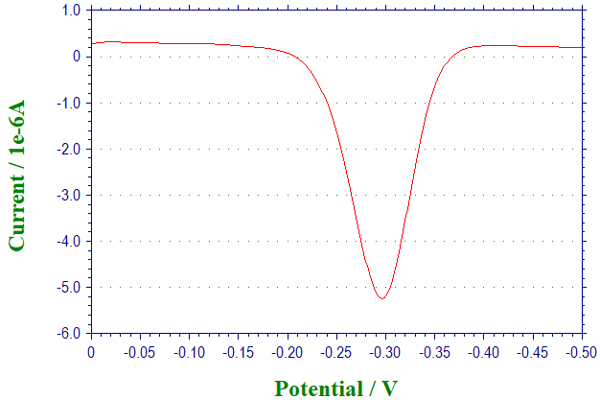



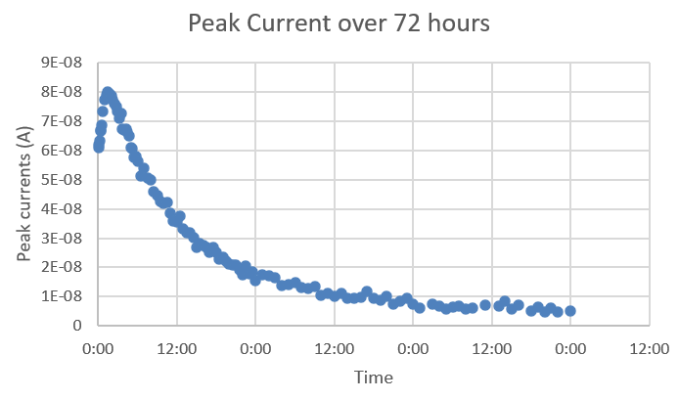
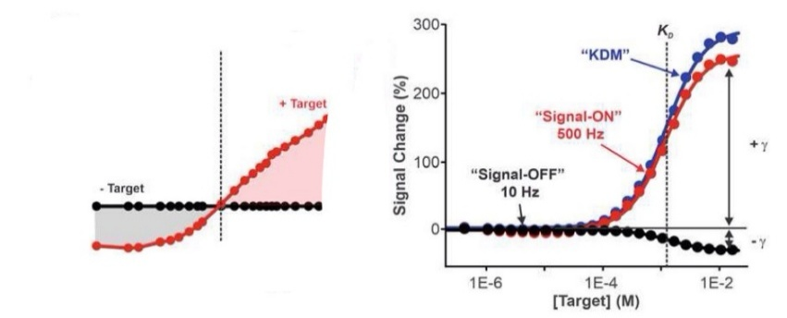
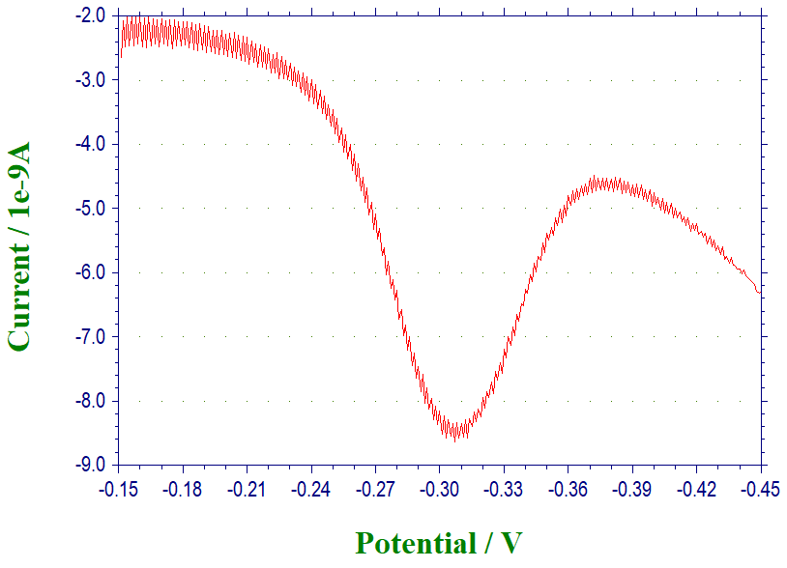
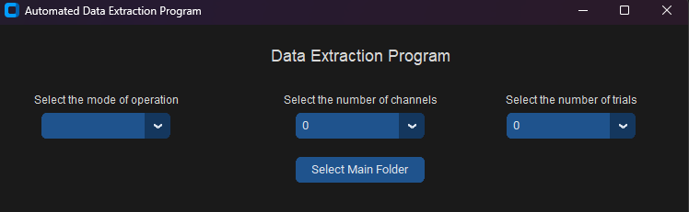
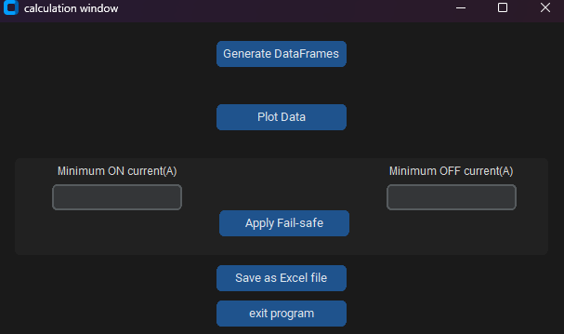


An Automated Data Processing Program for Electrochemical Aptamer-based Sensors
Derek Yeung¹, Surasak Kasetsirikul^{2,3}, Yi-Chin Toh^{2,3}
¹School of Electrical Engineering and Robotics, Queensland University of Technology
²Centre for Biomedical Technologies, Queensland University of Technology
³School of Mechanical, Medical and Process Engineering, Queensland University of Technology
Background
Electrochemical Aptamer-based Sensors
Research aim
2. Faulty data
User-defined minimum current to eliminate faulty data.
3D Advanced Culture Systems
1. Automate the entire data processing procedure.
2. Include the feature to identify and remove faulty data.
3. Implement alternative smoothing techniques to reliably remove noises in the data.
Faulty current
Regular current
Research methodology
3. Replaced Fourier Transform (FT) smoothing with Savitzky-Golay (SG) filtering
➢ It is required to have non-invasive and continuous tracking systems for cell viability and function.
➢ Automated data processing program is coded with Python programming.
➢ Electrochemical Aptamer-based sensors can reversibly capture and release the target in response to applied potential and frequency.
Research Problem
Electrochemical Readout
➢ Readout from developed Python program will be compared with manual data generated from various types of samples.
Previous manual procedures
Controlled samples data
Conclusions
Automated data processing program for electrochemical aptamer-based biosensors is delivered.
Introducing alternative smoothing technique to improve reliable denoising data.
Data files
Calculation
Compiled in Excel
Results & Discussion
In-medium samples data
Automated program
Degradation curve
Calibration curve
Preselection window
Calculation window
References & Acknowledgement
[1] E. Verrinder et al. 3, 1, 2024, 95–13,
[2] K. K. Leung et al. 6, 9, 2021, 3340–3347
➢ Current data processing is entirely manual
➢ Faulty data determination requires manual observation
➢ Current built-in smoothing algorithm (Fourier Transform function) is unreliable in more complex samples.

Slide 2
An Automated Data Processing Program for Electrochemical Aptamer-based Sensors
Abstract
Background
Electrochemical-Aptamer Based (E-AB) sensors was developed with the aim of providing a non-invasive and continuous method for monitoring tissue models (D.Ducharme, 2022). The sensors’ mechanism relies on the aptamers’ ability to recognise targeted molecules and reversibly capture and release the target in response to the applied potential and frequencies (D.Ducharme, 2022).
Research problem
In this project, the continuous monitoring of the EAB sensors will generate a lot of data and require data processing and analysis. When consulting with the experiment supervisor, three problems were identified in the previous methodology in data processing. The first problem was that the collected data were previously manually analysed, which is labour intensive, and the quality of the data relies on each user. Secondly, faulty data were observed occasionally within a dataset, which can heavily impact the results of the data analysis if went unnoticed. The last identified issue was the noises and interference observed from in-medium samples, and the limitation of the in-built Fourier Transform (FT) function at denoising in-medium data.
Aim of the study
The aim of this research was to address the identified issues by developing a program to enhance the data processing operation. The first goal is to automate the entire procedures of processing raw data into data visualisation. The second goal is to implement features within the program for easier identification and removal of faulty data. The final goal is to evaluate and replace the current FT function for smoothing the noisy data.
Methodology
The python program implement functions from multiple open libraries for data processing, calculation and a simple user interface. Beginning with pathlib, the program iterates through all Square-Wave Voltammetry (SWV) data in the correct folders. The pandas library was introduced to read each SWV data. Then, the savgol_filter from the scipy library was used to smooth noisy data and the peak current was calculated with numpy arithmetic functions. Further KDM & signal changes calculations was also performed within the program. For the visualisation of the curves, the program implements functions from the matplotlib. Finally, the program was refined with a simple user interface with the customtkinter library. This allows user to easily perform the automated data analysis with a high level of customisation and handling without in-depth knowledge about the code. In the end, the results from the program was compared to the results from the original method.
Findings
It was deduced that the faulty data were primarily caused by poor connections in the potentiostat during data collection. Since all the faulty current data were significantly smaller than the regular current data (in magnitude of 10s, 100s, sometimes more). Hence the fail-safe protocol is based on implementing a minimum/ threshold current which the user can determine after inspecting the dataset.
In the controlled PBS samples, the noises observed were periodic – assumed to be originated from the electrical instruments itself – and FT function can nicely denoise the data. However, the data in the medium samples displayed more spontaneous interference and current drifts, caused by proteins and blood cells in the complex biological system (K. K. Leung 2021, 3340). FT method was shown limited at denoising in-medium currents without preserving the key features of the drifted base current due to the limited sampling rate of the equipment during data collection. Addressing the needs of denoising whilst preserving the key features of the current, the Savizky-Golay (SG) filtering function was tested. Thanks to the locally fitting polynomial method of the SG filtering function, promising results were reflected in the lower standard deviation compared to the previous FT method (T. Konstantinovsky, 2024).
Implications
With the help of this automated program, it was foreseen that experiment supervisor can perform more data analyses with a much larger pool of SWV data whilst eliminating a significant amount of labour and time. Faulty data can be identified more quickly, and the filtering function can be more consistent across PBS and in-medium samples. For future improvement of the program, the shifted potential of potential window should be addressed. A customising function for the user to specify the potential window of the SWV data can greatly improve the accuracy of each peak current.
References
Dauphin-Ducharme, P., Ploense, K.L., Arroyo-Currás, N., Kippin, T.E. and Plaxco, K.W., 2022. Electrochemical aptamer-based sensors: a platform approach to high-frequency molecular monitoring in situ in the living body. Biomedical Engineering Technologies: Volume 1, pp.479-492.
K. K. Leung, A. M. Downs, G. Ortega, M. Kurnik, and K. W. Plaxco, “Elucidating the Mechanisms Underlying the Signal Drift of Electrochemical Aptamer-Based Sensors in Whole Blood,” ACS sensors, vol. 6, no. 9, pp. 3340–3347, 2021, doi: 10.1021/acssensors.1c01183.
Thomas Konstantinovsky. 2024. ‘Introduction to the Savitzky-Golay Filter: A Comprehensive Guide (Using Python)’. https://medium.com/pythoneers/introduction-to-the-savitzky-golay-filter-a-comprehensive-guide-using-python-b2dd07a8e2ce

